Slide 1
OIR Public Rate Hearing on Recommended Rates
Tim Cerio, President/CEO and
Executive Director
August 1, 2024

Slide 2
Proposed Rate Changes
Citizens’ statutory requirements for rate changes:
Rates must be actuarially sound pursuant to s. 627.062 and not competitive with approved rates charged in the admitted voluntary market, so that the corporation functions as a true residual insurer.
Citizens makes recommendations to the OIR for rate changes, and the OIR establish Citizens’ rates.
Product Line | In-Force Premium | Uncapped Indication | Non-Competitive % Change | Proposed Rate % Change
Personal Multi-peril | $3,237,890,190 | 23.1% | 92.8% | 13.9%
Personal Wind-Only | $332,306,870 | 73.2% | N/A | 15.0%
Commercial | $571,875,247 | 27.9% | N/A | 10.3%
Total | $4,142,072,307 | 27.8% |  | 13.5%

Slide 3
History of Citizens’ Homeowner Rate Changes
2002-2006 – Citizens’ rates based on Top 20 companies, must be actuarially sound, and not competitive with the private market.
2007 – House Bill 1A rolled Citizens’ rates back to 2006 levels, froze them until July 2009, and eliminated the requirement that Citizens’ rates be competitive and based on the Top 20 companies.
2008 – Mitigation credits are doubled resulting in rate decreases and Citizens’ rate freeze was extended until January 2010.
2010 – Following the 3-year rate freeze, Citizens’ rate increases are limited to 10% per policy, excluding coverage changes and surcharges, to allow a glidepath to actuarially sound rates.
2012 – Because of abusive practices and excessive claims, sinkhole coverage is removed from the base policy but remains optional and rated outside the 10% glidepath.
2018-2020 – Office of Insurance Regulation froze Monroe county rates.

Slide 4
History of Citizens’ Homeowner Rate Changes
2020 – No actuarial rate changes are filed, as directed by the Board of Governors, due to the COVID-19 pandemic.
2021 – Senate Bill 76 requires that Citizens’ rate calculations include the cost of reinsurance to cover 100-year PML, whether or not the coverage is purchased (within the glidepath). Citizens’ rate glidepath to increase by 1% each year until it reaches 15%.
2022 – Citizens’ rate glidepath increased to 11% per policy.
2023 – Citizens’ rate glidepath increased to 12% per policy, and rates are again required to be not competitive with the private market.
2024 – Citizens’ rate glidepath increased to 13% per policy.
2025 – Citizens’ rate glidepath will increase to 14% per policy.
2026 – Citizens’ glidepath will increase to and remain at 15% per policy.

Slide 5
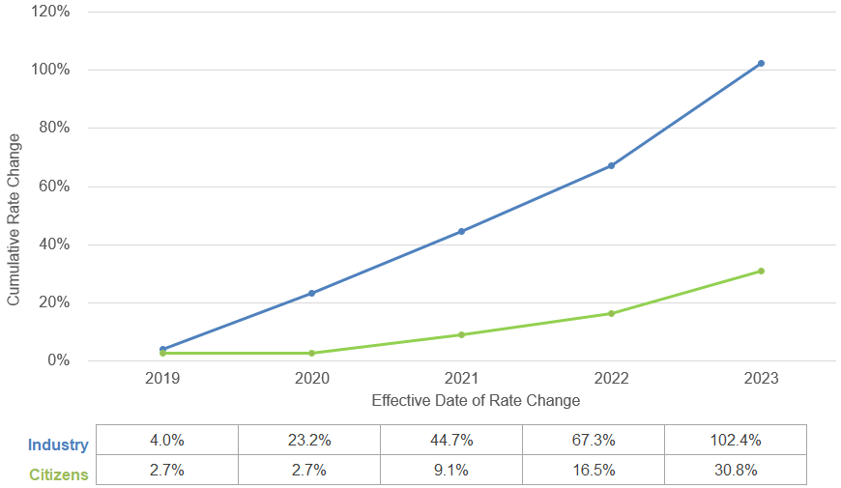

FL Homeowner Cumulative Rate Changes
Note: Annual rate changes for companies writing Homeowners (HO-3, HO-4, HO-5, HO-6 and HO-8) insurance in Florida.

Slide 6
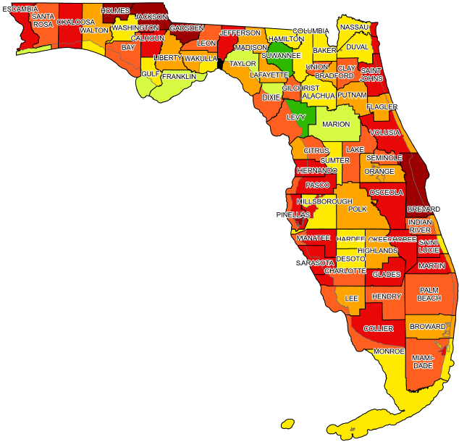
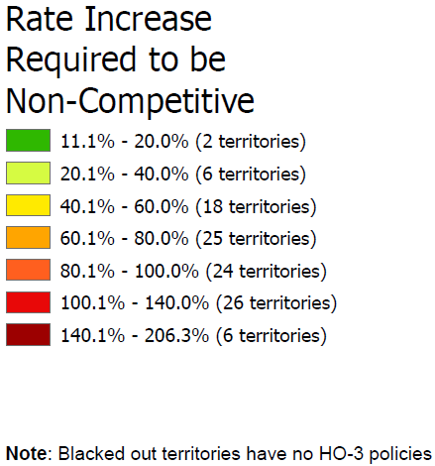
HO-3 Competitive Position
Ignoring 14% cap of the glidepath, to be non-competitive, Citizens’ HO-3 rates will need an increase of 96.8% on a statewide basis, using 12/31/2023 policy data.

Slide 7
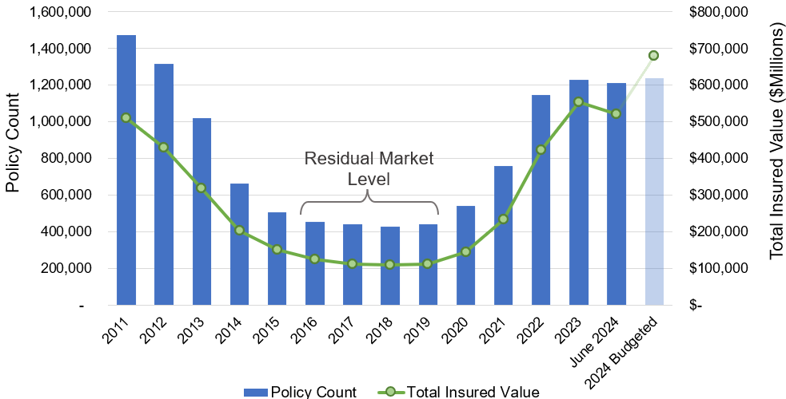
Policy Count and Total Insured Value

Slide 8
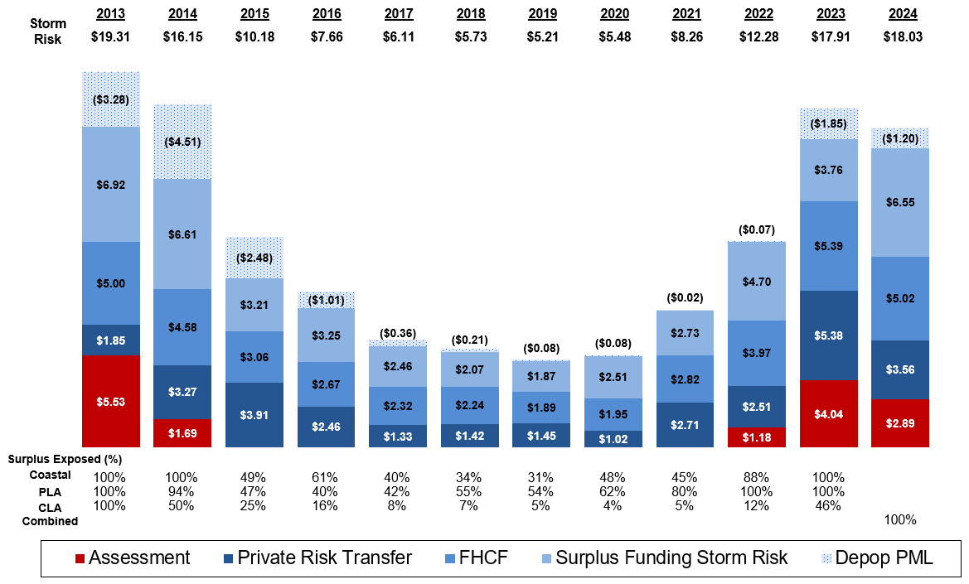
Risk and Assessment Trend (in Billions)
See the Appendix for the underlying notes and assumptions

Slide 9
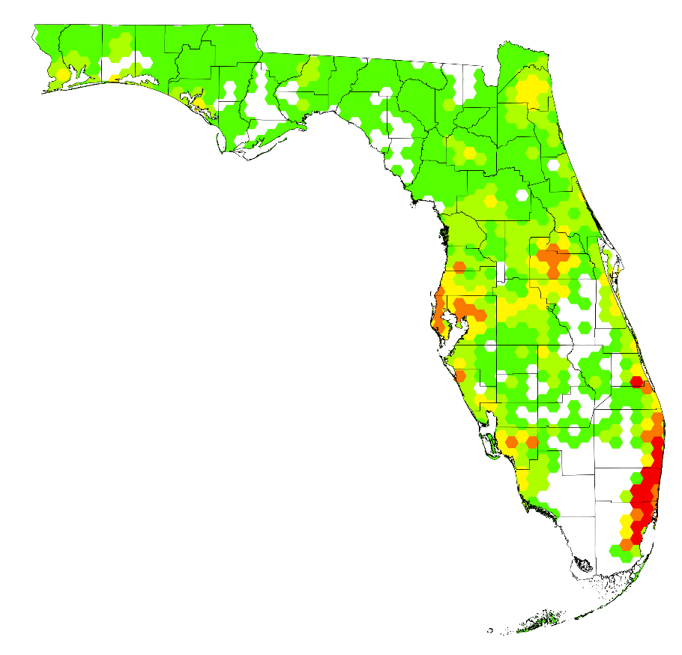
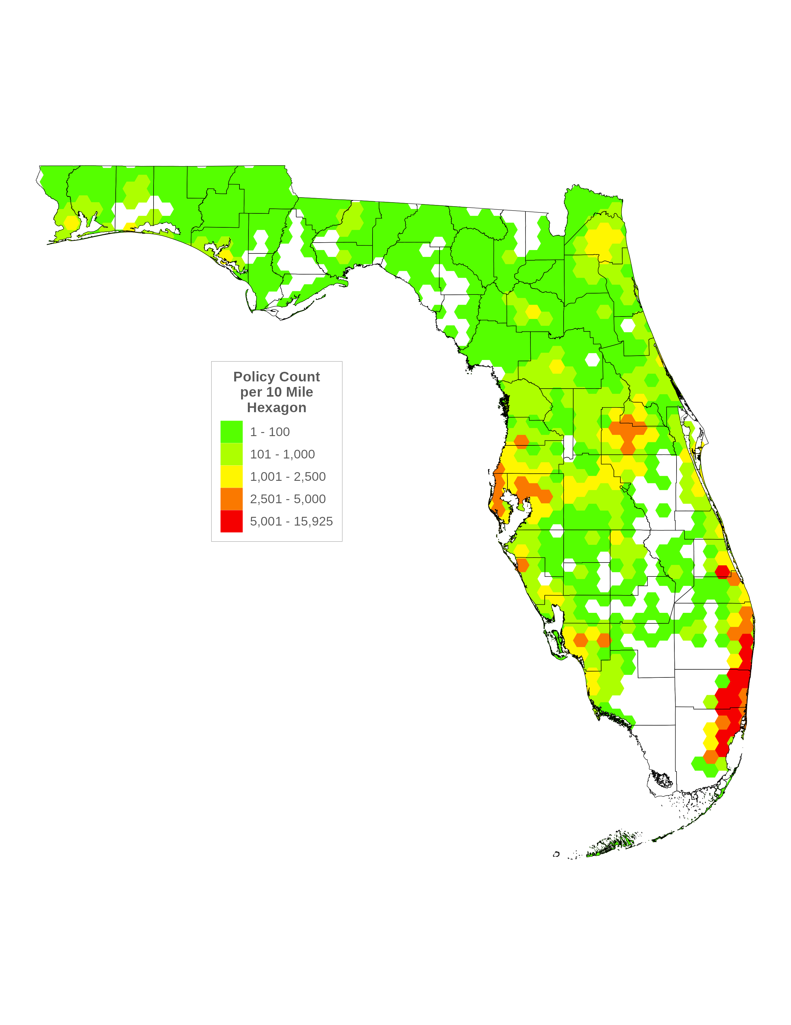
Depopulation Activity
Policy Count
per 10 Mile Hexagon
1 – 100
101 – 1,000
1,001 – 2,500
2,501 – 5,000
5,001 – 15,925
Notes:
Policyholder Choice Letters Mailed indicates the number of depopulation letters mailed, one per policy. Multiple offers may be contained in a single mailing.
The hexagon map shows all personal lines and commercial lines (CL) policies assumed from April 2023 through May 2024

Slide 10
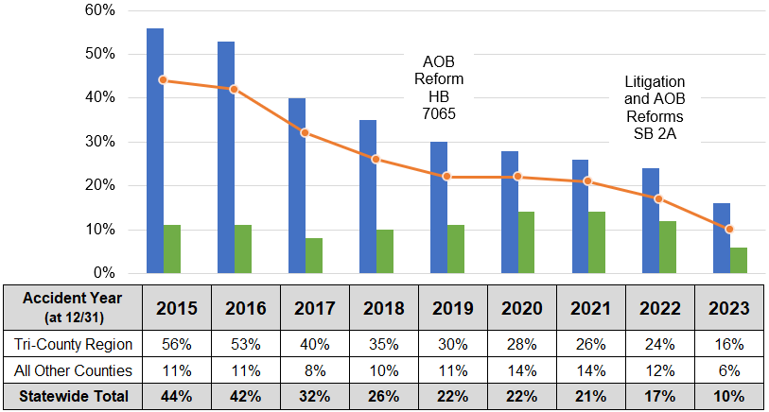
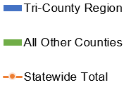
Litigation and Assignment of Benefit (AOB) Reforms
Projected Percent of Citizens’ Non-Catastrophe HO-3 Litigated Claims
Notes:
The tri-county region includes Broward, Palm Beach and Miami-Dade Counties
Senate Bill 2A was effective 12/16/2022; however, language changes were not incorporated into Citizens’ policy forms until 06/01/2023.

Slide 11
OIR Public Rate Hearing on Recommended Rates
Brian Donovan, Vice President – Chief Actuary
August 1, 2024

Slide 12
Proposed Rate Changes
Product Line | In-Force Premium | Uncapped Indication | Non-Competitive % Change | Proposed Rate % Change
Personal Multi-peril | $3,237,890,190 | 23.1% | 92.8% | 13.9%
Personal Wind-Only | $332,306,870 | 73.2% | N/A | 15.0%
Commercial | $571,875,247 | 27.9% | N/A | 10.3%
Total | $4,142,072,307 | 27.8% |  | 13.5%
Uncapped Indication is the increase needed for Citizens’ rates to be actuarially sound, considering the impacts of Senate Bill 2A (SB 2A).
Non-Competitive % Change is the increase needed for Citizens’ rates to be non-competitive.
Proposed Rate % Change is the recommended rate change that considers all the above.

Slide 13
SB 2A Reform Impacts
Excess litigation has been the primary cause of the poor health of the Florida Property Insurance Market.
In 2021, Florida comprised 9% of property claims countrywide but over 81% of the residential property insurance litigation suits.*
SB 2A directly addressed this issue of excessive litigation by eliminating the use of Assignment of Benefits (AOBs) as well as the one-way attorney fee statute.
These changes are expected to drastically reduce future litigation, reducing the crippling costs associated with the excessive number of lawsuits.
This anticipated savings is included in the rate indication calculations, resulting in substantial savings.
SB 2A has lowered Citizens’ premium need by over $500M for 2025.
*Source: https://www.businessobserverfl.com/article/floridas-insurance-litigation-problem-stares-deep-into-an-abyss

Slide 14
Improvement in Results
Product Lines | 2024 Rate Indication |  |  | 2025 Rate Indication
 | Unadjusted | SB 2A Adjustments | Approved Rate Change | Unadjusted | SB 2A Adjustments
HO-3 and HW-2 | 91.5% | 55.1% | 12.6% | 40.9% | 25.2%
The primary driver of the improved results is the continued decrease in litigation rates for non-catastrophe losses.
Accident Year | HO-3 Non-Catastrophe Litigation Projected % of Claims Litigated
 | Southeast Counties * | Rest of State | Statewide
12/31/2015 | 56% | 11% | 44%
12/31/2016 | 53% | 11% | 42%
12/31/2017 | 40% | 8% | 32%
12/31/2018 | 35% | 10% | 26%
12/31/2019 | 30% | 11% | 22%
12/31/2020 | 28% | 14% | 22%
12/31/2021 | 26% | 14% | 21%
12/31/2022 | 24% | 12% | 17%
12/31/2023 | 16% | 6% | 10%
Adjustments for SB 2A
Restated historical litigation rates
Restated historical AOB severities
Removed litigation costs from the non-hurricane catastrophe provision
Selected a mid-point of the four hurricane models
* Includes Miami-Dade, Broward and Palm Beach

Slide 15
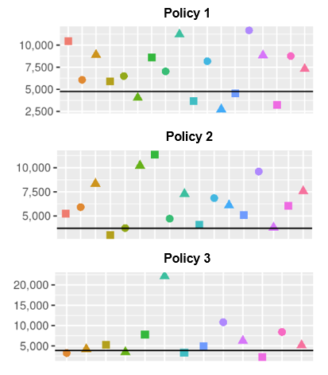
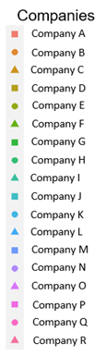
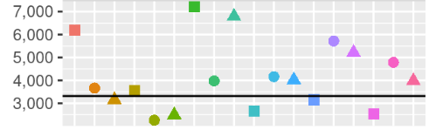
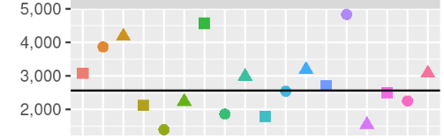
Competitive Analysis
To determine competitiveness, insurers’ rating manuals were provided in October 2023 and used to determine premiums for Citizens’ HO-3, HO-6 and DP-3 policy data as of 12/31/2023.
The analysis used the 75th percentile as the selected “non-competitive” premium.
Policy Examples of Competitors’ Premiums
Citizens’ Premium
Market Share as of 9/30/2023
Policy Type | Number of Competitors | Competitors & Citizens’ Market Share
HO-3 | 18 | 63.5%
HO-6 | 15 | 60.0%
DP-3 | 11 | 78.9%
Citizens’ Premium
Citizens’ Premium

Slide 16
Competitive Analysis Methodology
Company | Competitor Premium
G | $7,201
I | $6,790
A | $6,188
N | $5,717
O | $5,213
Q | $4,785
K | $4,163
L | $4,019
R | $3,979
H | $3,977
B | $3,663
D | $3,549
C | $3,155
M | $3,154
J | $2,654
P | $2,532
F | $2,492
E | $2,261
The 18 competitor premiums are listed in descending order for Policy 2.
The 75th percentile is defined to be the value such that 4.5 of the values are above that value, and for this policy, it is $5,106.
Citizens’ premium of $3,318 will need to be increased by 53.9% to be non-competitive.
The proposed premium is $3,763.
The percent change needed for each territory to become non-competitive is determined by taking averaged policy level data using Citizens’ premiums as the weights.
75th Percentile Premium
Citizens’ Proposed Premium
Citizens’ Current Premium

Slide 17
Competitive Analysis HO-3 Results
HO-3 Policies as of 12/31/2023
Region / County | Policy Count | Increase Needed to be Non-Competitive | Number of Competitive Policies | Number of Competitive Policies After 14% Increase | Proposed Rate Change
Broward | 71,526 | 74.1% | 71,472 | 70,992 | 13.5%
Central East Coast | 107,304 | 117.0% | 107,205 | 106,870 | 13.7%
Dade | 97,222 | 82.6% | 97,142 | 96,518 | 13.5%
Inland | 53,834 | 82.2% | 53,237 | 51,902 | 13.6%
Monroe | 1,418 | 49.1% | 1,303 | 1,167 | 16.2%
North East Coast | 40,519 | 86.1% | 40,389 | 39,781 | 13.5%
North Gulf Coast | 170,579 | 112.3% | 168,778 | 162,616 | 13.5%
Palm Beach | 61,705 | 80.5% | 61,583 | 60,930 | 13.4%
Panhandle | 21,393 | 101.6% | 21,096 | 20,631 | 13.2%
South Gulf Coast | 56,114 | 100.9% | 55,790 | 54,971 | 13.5%
TOTAL | 681,614 | 96.8% | 677,995 | 666,378 | 13.5%
For Citizens’ rates to be non-competitive, they would need to be doubled.
Based on this information, the maximum increase of 14% in most territories is recommended.
Even after a 14% increase, 98% of policies remain competitive.
Excludes policies marked for takeout

Slide 18
Primary vs Non-Primary
SB 2A requires Citizens to cap all non-primary policies between 0% and 50%.
Personal Lines | PRIMARY |  | NON-PRIMARY |  | TOTAL |  | Non-Primary Policy Count | Non-Primary % of Policy Count
 | In-Force Premium | Proposed Change | In-Force Premium | Proposed Change | In-Force Premium | Proposed Change
Homeowners | $2,536,522,507 | 13.4% | $121,286,837 | 17.9% | $2,657,809,344 | 13.6% | 24,978 | 3.4%
Renters | $1,950,271 | 12.9% | $84,080 | 23.1% | $2,034,351 | 13.3% | 199 | 2.2%
Condo Units | $103,324,083 | 13.5% | $36,492,937 | 15.0% | $139,817,020 | 13.9% | 18,876 | 21.3%
Dwelling DP3 | $479,906,002 | 13.5% | $33,321,618 | 25.9% | $513,227,620 | 14.3% | 13,780 | 6.0%
Dwelling DP1 | $113,386,507 | 13.2% | $5,009,030 | 24.1% | $118,395,537 | 13.6% | 1,771 | 3.4%
Mobile Home (MH) | $83,191,926 | 13.4% | $36,035,335 | 42.2% | $119,227,261 | 22.1% | 16,834 | 26.0%
Dwelling MH | $15,594,913 | 13.6% | $4,091,016 | 39.6% | $19,685,929 | 19.0% | 3,429 | 17.4%
Total | $3,333,876,210 | 13.4% | $236,320,851 | 22.8% | $3,570,197,061 | 14.0% | 79,867 | 6.7%
The recommended change for primary is 13.4% versus 22.8% for non-primary.
Non-primary makes up 6.7% of the total personal lines policies but varies greatly by line of business.
Non-primary polices make up a much larger percentage of the book of business in the mobile home and condominium unit lines of business.

Slide 19
Conclusions
Rates must be actuarially sound pursuant to s. 627.062, F.S., and not competitive with approved rates charged in the admitted voluntary market, so that the corporation functions as a true residual insurer.
With the implementation of SB 2A and improvement in the litigation rates, Citizens’ overall rate need for actuarial soundness has shown great improvement in the last two years.
SB 2A results in savings for Citizens, which reduces the probability and severity of assessments.
Even if the proposed rate changes are approved, Citizens’ rates will not be actuarially sound and more importantly, 98% of policies will remain overly competitive.
Recommendations meet the dual statutory requirements of moving rates towards actuarial soundness and non-competitiveness while also adhering to the 14% glidepath.

Slide 20
Appendix

Slide 21
Slide 8 Notes and Assumptions
Storm Risk is as measured by the 1-in-100 year probable maximum loss (PML) plus estimated loss adjustment expenses using the Florida Hurricane Catastrophe Fund (FHCF) account allocation where PLA and CLA are combined for years 2013 through 2023. In these years, PLA/CLA combined PMLs are added to the Coastal PMLs to be consistent for surplus distribution. As of January 2024, Citizens combined the three accounts into a single account. In general, the PMLs presented are as projected at the beginning of storm season; with the exception of 2017 which is as of 08/31, 2021 is as of 09/30, 2022 is as of 9/30, 2023 is as of 9/30, and 2024 is projected to 09/30.
Surplus and Assessments are as projected at beginning of storm season. Not all PLA/CLA surplus is needed to fund storm risk in 2014. In 2015 - 2021, not all surplus in PLA/CLA and the Coastal Account is needed to fund storm risk. Any remaining surplus available within an individual account is available to fund a second event. As mentioned above, beginning January 2024, Citizens combined the PLA, CLA and Coastal Account into a single “Citizens” account. The surplus from each is combined from this point forward.
Florida Hurricane Catastrophe Fund (FHCF) is as projected at beginning of storm season; except for 2017, 2018, 2021 and 2022 which are Citizens' initial data submission to the FHCF.
Private Risk Transfer amounts presented in the graph reflect the full amount secured regardless of the attachment or exhaustion point. In 2016, 2022 and 2023, coverage extended beyond the 1-in-100 year event level. In these cases, the sum of the components exceeds the Storm Risk.
Assessments are the sum of the Policyholder Surcharge, Regular Assessment (where applicable), and the Emergency Assessment. Beginning with 2024, the Regular Assessment is no longer an available funding source due to the combing of the three accounts into a single “Citizens” account.
Depopulation PMLs are not included in storm risk totals and are presented as year end totals unless otherwise noted. PMLs from 2011-2014 use a weighted average of 1/3 Standard Sea Surface Temperature (SSST) and 2/3 Warm Sea Surface Temperature (WSST). 2015 - 2021 PMLs reflect only SSST event catalog. Starting with year-end 2021, PML results displayed are 50K US Hurricane, Florida Regulatory (SSST) Event Set. 2024 Depopulation PML is based on takeouts through June 25, 2024.

